Slide 1
Variables, Statements and Expressions
Second class

Slide 2
Plan for today
Variable assignment
Variable types
Variable names
Expressions and Statements
Order of operations
Script mode VS Interactive mode
Computer memory
Comments
Debugging (3 types of errors)

Slide 3
Variables as boxes

Slide 4
Variables as boxes
Variable is a box that stores something!

Slide 5
Variable assignment
Computers can do only 3 things:
Perform calculation
Remember what was calculated
Decide when to stop
Repeat previous 3 steps many times
Today we focus on second part

Slide 6
Variable assignment
Remember what was calculated = Store results
In order to store results, following should be defined:
What should be stored
Where should be stored
Why should we deal with data storage and variable assignment?

Slide 7
Computer memory model
Think about computer memory as a grid.
When you input some value, it is stored at some place in grid.
It has internally generated number (reference) which says on which part of grid data is stored.
Internally generated number is awkward, large, complex. It is difficult to remember it.
So, instead, we use variable to reference value stored in memory.

Slide 8
Computer memory

Slide 9
Variable as box
Think about variable as box in which we store value.
Box is place in memory which is occupied by data.
Name of box is variable’s name.

Slide 10
Valid name for variable
Letters, numbers and underscore are legal
Name can’t start with number
Same name for variable and function is not possible

Slide 11
Valid name for variable
Can’t use keyword as name for function
If you want your variable name to be same as reserved keyword, just add trailing underscore.
e.g. from_, import_, global_

Slide 12
Python reserved keywords
How to find list of all keywords in python?
help(‘keywords’)

Slide 13
Variables
Simple variables
Int, float, boolean, None
Compound variables
String, list, tuple, set, dictionary, frozenset

Slide 14
Variables
Two types of variables in python:
Mutable
Immutable

Slide 15
Types of variables
Integer
Floats
Boolean
(None)
Strings
List
tuples
Set, frozen set
Dictionary

Slide 16
What can we do with variables?
Python operators:
Arithmetic
Assignment
Comparison
Logical
Membership
Bitwise
Identity

Slide 17
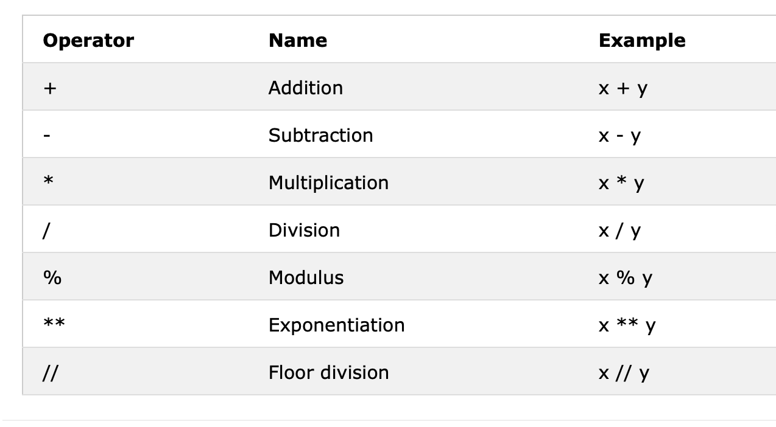
Arithmetic operator

Slide 18
Assignment operator
From right to left principle.
Different ways to assign value to variable.
Variable reassignment - value update !!!

Slide 19
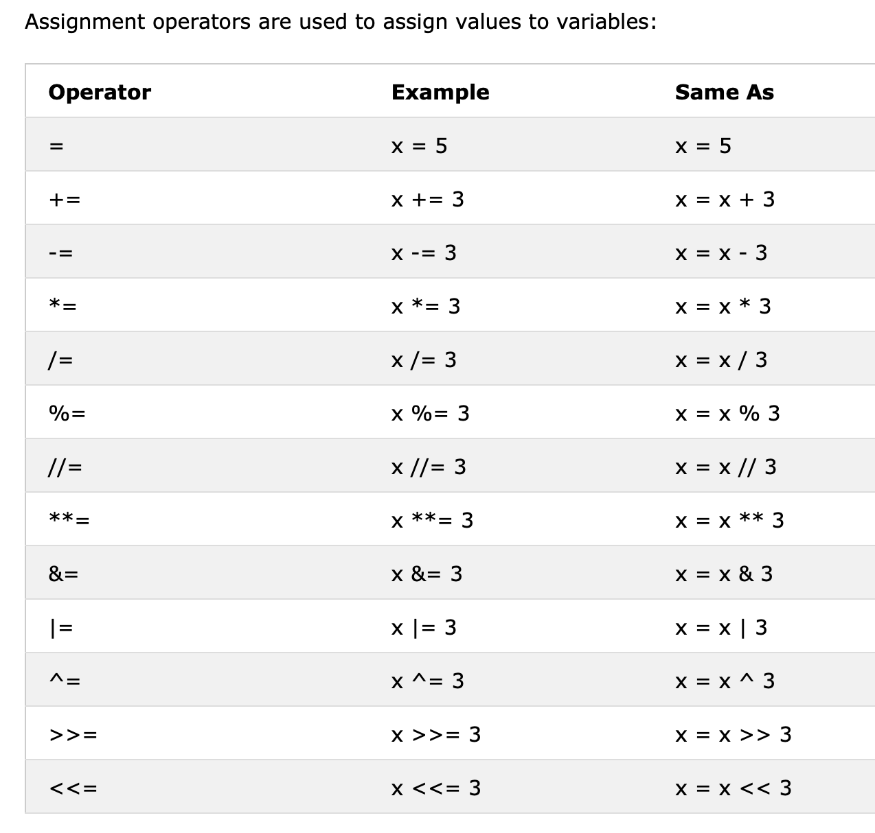
Assignment operator

Slide 20
Assignment operator
Examples:
Multiple assignments (2 types)
a , b = 2 , 3
a=4; b=a
How to change values of variables?

Slide 21
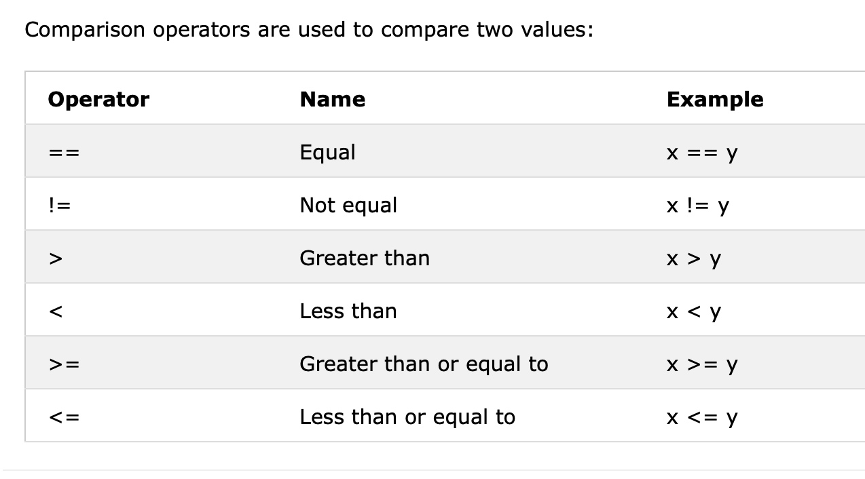
Comparison operator

Slide 22
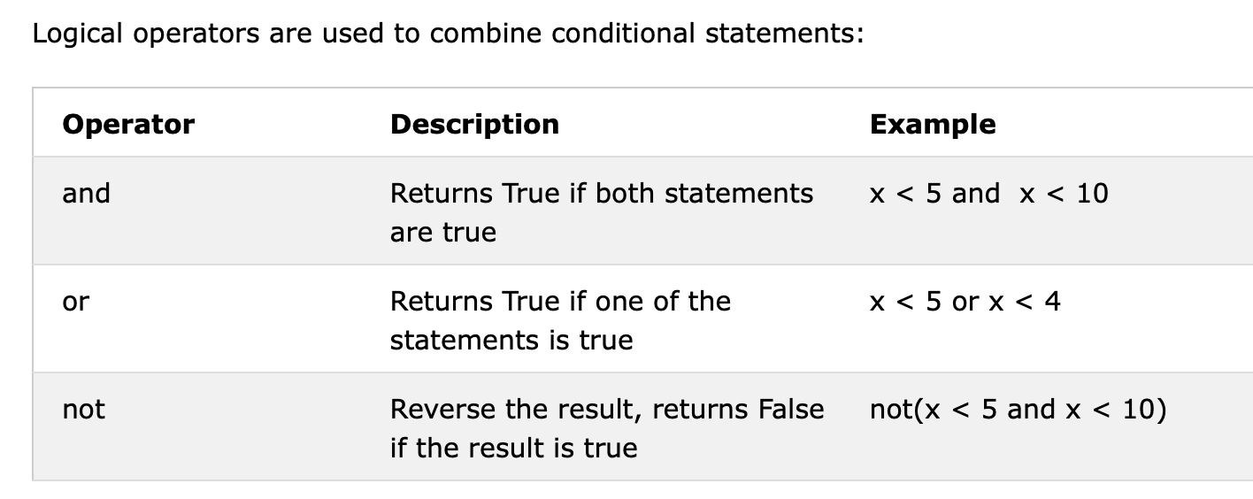
Logical operator

Slide 23
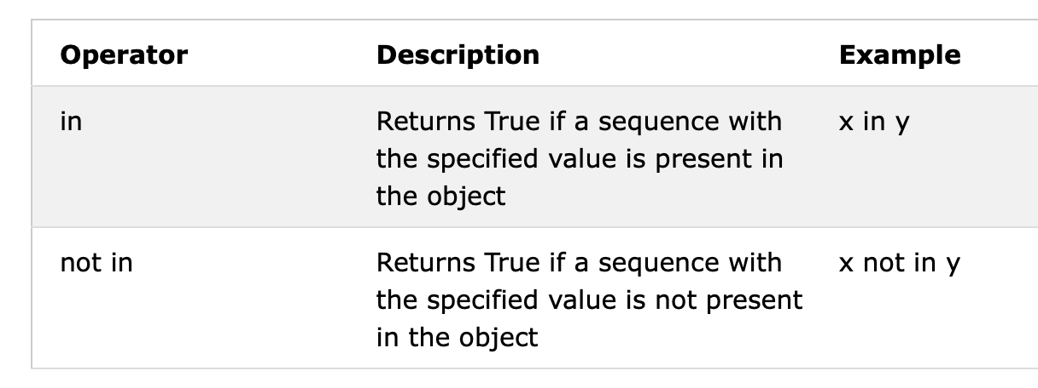
Membership operator
… used to check if element is present in container/collection.

Slide 24
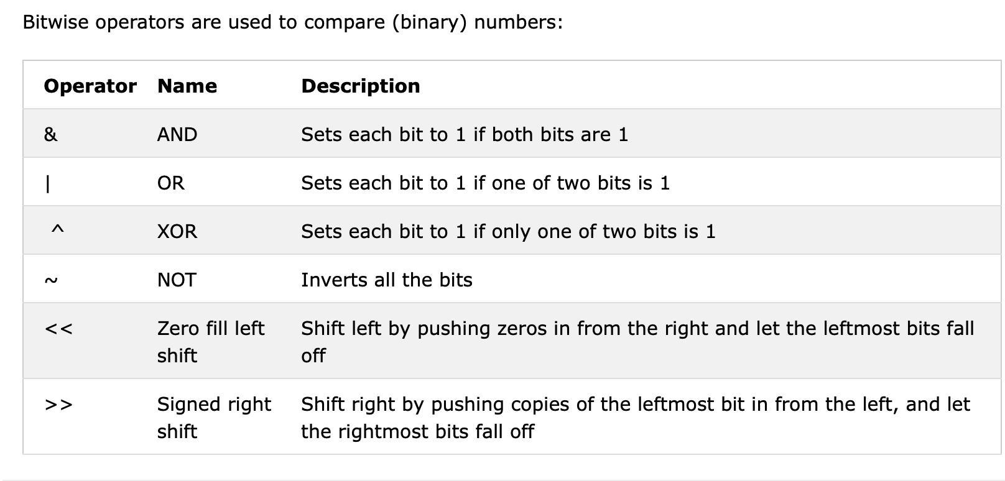
Bitwise operator

Slide 25
Truth tables
AND, OR, XOR, NOT.

Slide 26
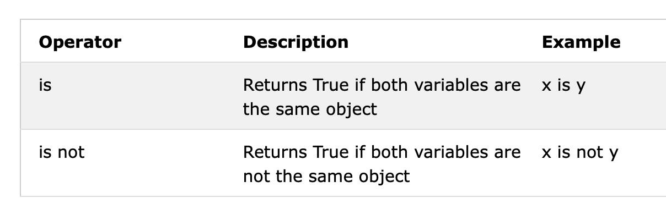
Identity operator
… used to compare two objects, not whether they are equal, but if they are actually same object.

Slide 27
Script VS Interactive mode
What are different ways to run python program?

Slide 28
Comments
Not what is done. (We can see it by reading code.)
But, why is that done this way !!!

Slide 29
Statements/expressions
Statement is instruction that python interpreter can execute.
A script usually consists of sequence of statements.
An expression is a combination of values, variables and operators.

Slide 30
Operators VS Operands
Expression: 2 + 3
Operators
+
Operands
2,3

Slide 31
Order of operations
PEMDAS
P - parenthesis
E - exponentiation
M and D - multiplication and division
A and S - addition and subtraction

Slide 32
Composition
Just combination of operators, operands and variables.
We can use brackets to change order of execution.

Slide 33
Debugging
3 types of errors:
Syntax errors
Runtime errors
Semantic errors

Slide 34
Special functions
type( )
id( )

Slide 35
Type conversion
Int, float, string

Slide 36
Useful rules
Creating new variable with same name == overriding variable.
When we assign value to variable, only values up to that moment are relevant. Everything after, doesn’t count.

Slide 37
Useful rule
Something that happen after can’t affect to things that happened before.
Importance of past and irrelevance of future.

Slide 38
About syntax
What are codes?
Those are words behind which commands/instructions are ‘hidden.’
By writing codes, we are giving PC instructions what to do.

Slide 39
High level VS low level
High level eg Python
Interpreter is made in a way that it can make conclusions about many things ie it can infer things.
Because it should infer things, it has more things to do. So it executes slower.
Low level eg C++
Many things should be specified.
Developer needs to specify exactly what he wants.
Compiler is not meant to guess anything.

Slide 40
When to stop?
Why do we need snippet x=x+1?
Where do we use it?
Does it have alternative?

Slide 41
When to stop?
It can be used to tell us when to stop execution of code segment.
After value of X exceeds some threshold, then break ie. stop executing some block of code.

Slide 42
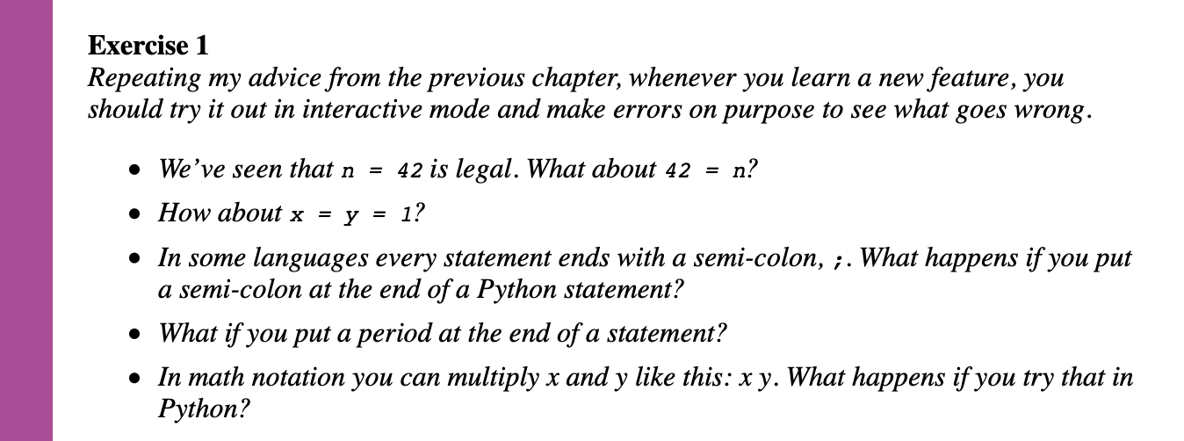
Exercises

Slide 43
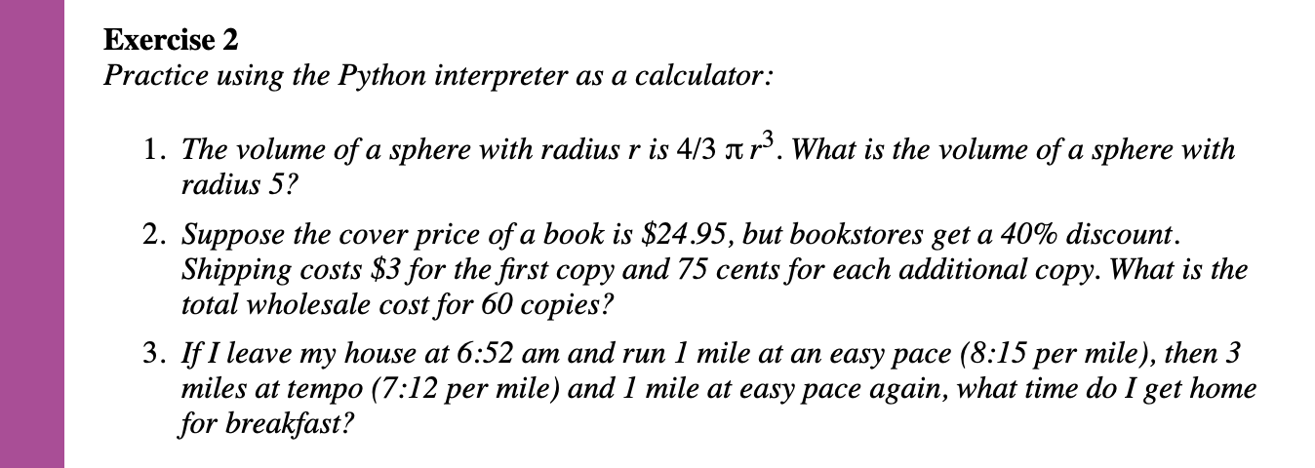
Exercises

Slide 44
The end
Thank you for your most valuable resource. Your time.

